Slide 1
Introduction to Deep Learning: Algorithms and Their Applications
CDC Short Course
Xiaoming Huo, Georgia Tech

Slide 2
Schedule
8:30-9:30 Module 1: Introduction
9:45-10:45 Module 2: Overview & preparation
11:00-12:00 Module 3: Neural networks - basics
12:00-1:15 Lunch break
1:15-2:00 Module 4: Neural networks - models
2:15-3:00 Module 5: Convolutional neural networks
3:15-4:00 Module 6: Some examples
4:00 Adjourn
Online resources: https://github.com/xhuo17/CDC_DL_2022

Slide 3
Advocating Statements for Deep Learning

Slide 4
So what is Deep (Machine) Learning?
A few different ideas:
(Hierarchical) Compositionality
Cascade of non-linear transformations
Multiple layers of representations
End-to-End Learning
Learning (goal-driven) representations
Learning to feature extraction
Distributed Representations
No single neuron “encodes” everything
Groups of neurons work together

Slide 5
Hierarchical Compositionality
VISION
pixels
edge
texton
motif
part
object
SPEECH
sample
spectral band
formant
motif
phone
word
NLP
character
word
NP/VP/..
clause
sentence
story
Slide Credit: Marc'Aurelio Ranzato, Yann LeCun

Slide 6
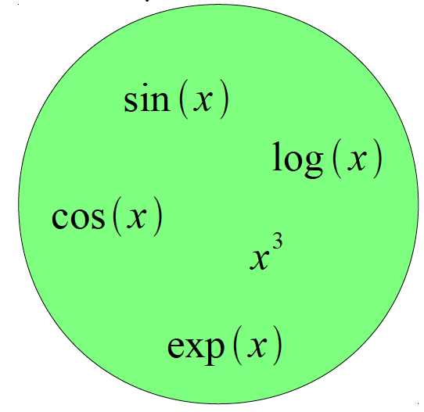
Building A Complicated Function
Given a library of simple functions
Compose into a
complicate function
Slide Credit: Marc'Aurelio Ranzato, Yann LeCun

Slide 7
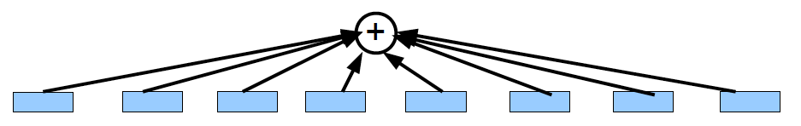
Building A Complicated Function
Given a library of simple functions
Idea 1: Linear Combinations
Boosting
Kernels
…
Compose into a
complicate function
Slide Credit: Marc'Aurelio Ranzato, Yann LeCun

Slide 8
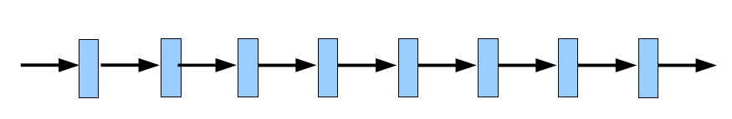
Building A Complicated Function
Given a library of simple functions
Idea 2: Compositions
Deep Learning
Grammar models
Scattering transforms…
Compose into a
complicate function
Slide Credit: Marc'Aurelio Ranzato, Yann LeCun

Slide 9
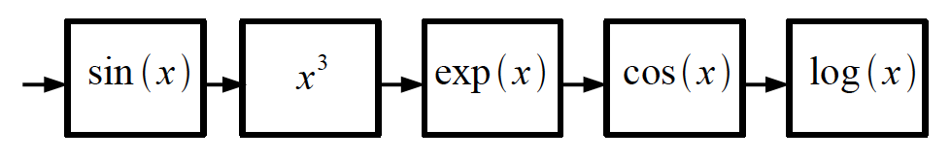
Building A Complicated Function
Given a library of simple functions
Idea 2: Compositions
Deep Learning
Grammar models
Scattering transforms…
Compose into a
complicate function
Slide Credit: Marc'Aurelio Ranzato, Yann LeCun

Slide 10
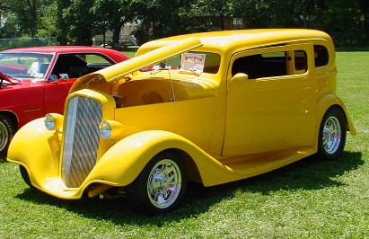
Deep Learning = Hierarchical Compositionality
“car”
Slide Credit: Marc'Aurelio Ranzato, Yann LeCun

Slide 11
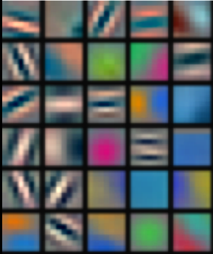
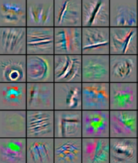
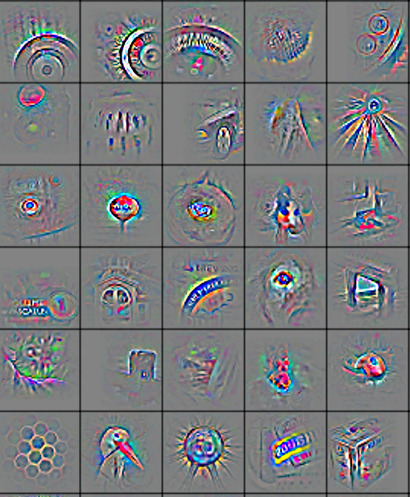
Deep Learning = Hierarchical Compositionality
Low-Level Feature
Mid-Level Feature
High-Level Feature
Trainable Classifier
“car”
Feature visualization of convolutional net trained on ImageNet from [Zeiler & Fergus 2013]
Slide Credit: Marc'Aurelio Ranzato, Yann LeCun

Slide 12
So what is Deep (Machine) Learning?
A few different ideas:
(Hierarchical) Compositionality
Cascade of non-linear transformations
Multiple layers of representations
End-to-End Learning
Learning (goal-driven) representations
Learning to feature extraction
Distributed Representations
No single neuron “encodes” everything
Groups of neurons work together

Slide 13

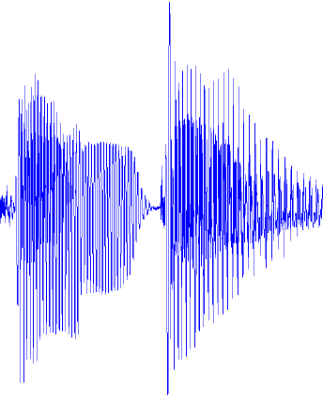
Traditional Machine Learning
VISION
hand-crafted features
SIFT/HOG
your favorite classifier
“car”
fixed
learned
SPEECH
hand-crafted features
MFCC
your favorite classifier
\ˈd ē p\
fixed
learned
NLP
hand-crafted features
Bag-of-words
your favorite classifier
This burrito place
is yummy and fun!
“+”
fixed
learned
Slide Credit: Marc'Aurelio Ranzato, Yann LeCun

Slide 14
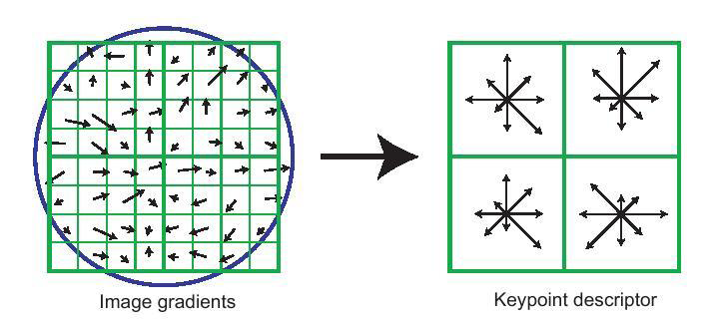
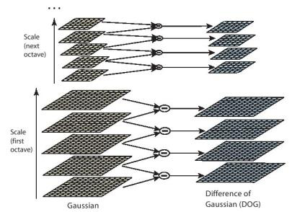
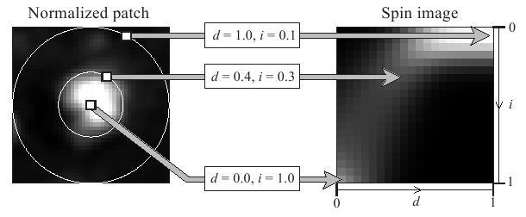
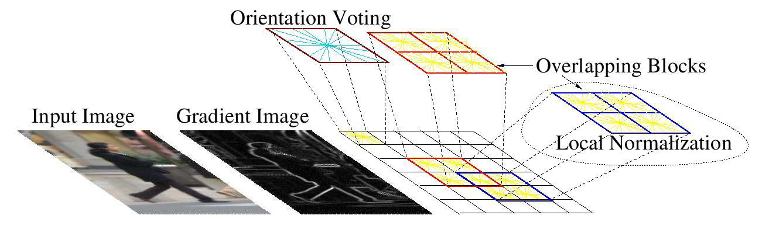
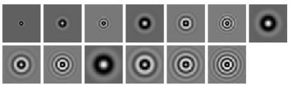
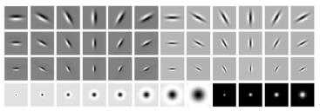
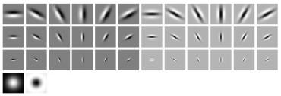
Feature Engineering
SIFT
Spin Images
HoG
Textons
and many many more….

Slide 15
Traditional Machine Learning (more accurately)
“Learned”
VISION
SIFT/HOG
K-Means/
pooling
classifier
“car”
fixed
unsupervised
supervised
SPEECH
MFCC
Mixture of
Gaussians
classifier
\ˈd ē p\
fixed
unsupervised
supervised
NLP
Parse Tree
Syntactic
n-grams
classifier
This burrito place
is yummy and fun!
“+”
fixed
unsupervised
supervised
Slide Credit: Marc'Aurelio Ranzato, Yann LeCun

Slide 16
Deep Learning = End-to-End Learning
“Learned”
VISION
SIFT/HOG
K-Means/
pooling
classifier
“car”
fixed
unsupervised
supervised
SPEECH
MFCC
Mixture of
Gaussians
classifier
\ˈd ē p\
fixed
unsupervised
supervised
NLP
Parse Tree
Syntactic
n-grams
classifier
This burrito place
is yummy and fun!
“+”
fixed
unsupervised
supervised
Slide Credit: Marc'Aurelio Ranzato, Yann LeCun

Slide 17
“Shallow” vs Deep Learning
“Shallow” models
Deep models
hand-crafted
Feature Extractor
“Simple” Trainable
Classifier
fixed
learned
Trainable Feature-Transform / Classifier
Trainable Feature-Transform / Classifier
Trainable Feature-Transform / Classifier
Learned Internal Representations
Slide Credit: Marc'Aurelio Ranzato, Yann LeCun

Slide 18
So what is Deep (Machine) Learning?
A few different ideas:
(Hierarchical) Compositionality
Cascade of non-linear transformations
Multiple layers of representations
End-to-End Learning
Learning (goal-driven) representations
Learning to feature extraction
Distributed Representations
No single neuron “encodes” everything
Groups of neurons work together

Slide 19
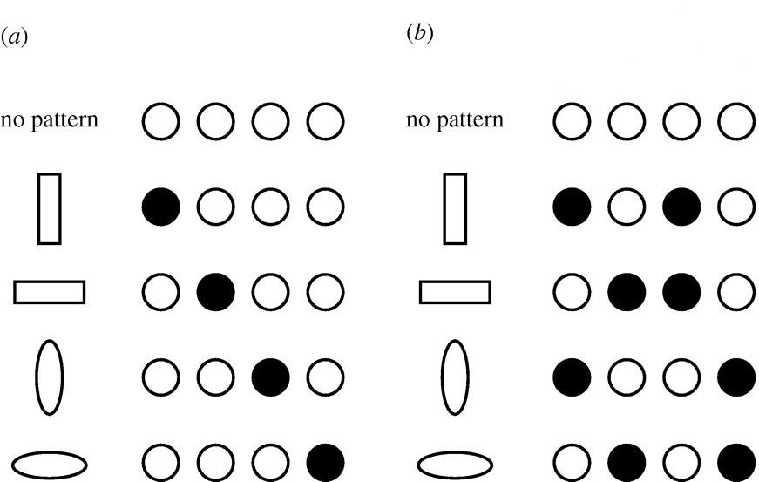
Distributed Representations Toy Example
Local vs Distributed
Slide Credit: Moontae Lee

Slide 20
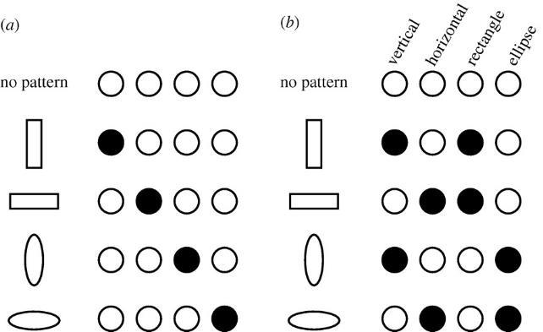
Distributed Representations Toy Example
Can we interpret each dimension?
Slide Credit: Moontae Lee

Slide 21
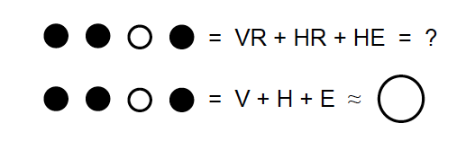
Power of distributed representations!
Local
Distributed
Slide Credit: Moontae Lee

Slide 22
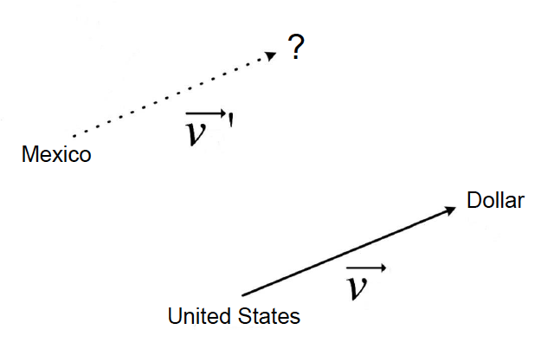
Power of distributed representations!
United States:Dollar :: Mexico:?
Slide Credit: Moontae Lee

Slide 23
So what is Deep (Machine) Learning?
A few different ideas:
(Hierarchical) Compositionality
Cascade of non-linear transformations
Multiple layers of representations
End-to-End Learning
Learning (goal-driven) representations
Learning to feature extraction
Distributed Representations
No single neuron “encodes” everything
Groups of neurons work together

Slide 24
Potential Problems with Deep Learning

Slide 25
Problems with Deep Learning
Problem#1: Lack of a formal understanding
Non-Convex! Non-Convex! Non-Convex!
Depth>=3: most losses non-convex in parameters
Worse still, existing intuitions from classical statistical learning theory don’t seem to carry over.
Theoretically, we are stumbling in the dark here
Standard response #1
“Yes, but this just means there’s new theory to be constructed”
“All interesting learning problems are non-convex”
For example, human learning
Order matters → wave hands → non-convexity
Standard response #2
“Yes, but it often works!”

Slide 26
Problems with Deep Learning
Problem#2: Lack of interpretability
Hard to track down what’s failing
Pipeline systems have “oracle” performances at each step
In end-to-end systems, it’s hard to know why things are not working

Slide 27
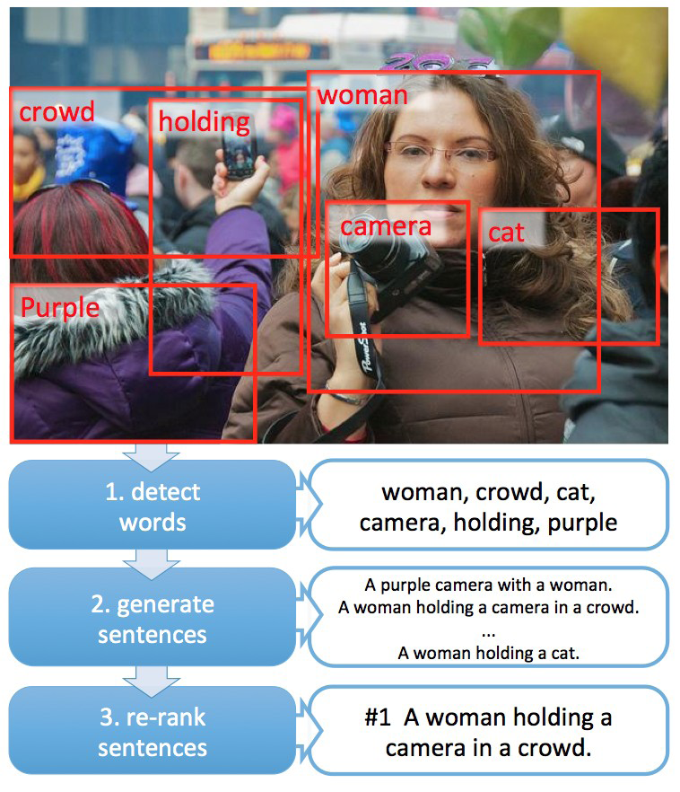
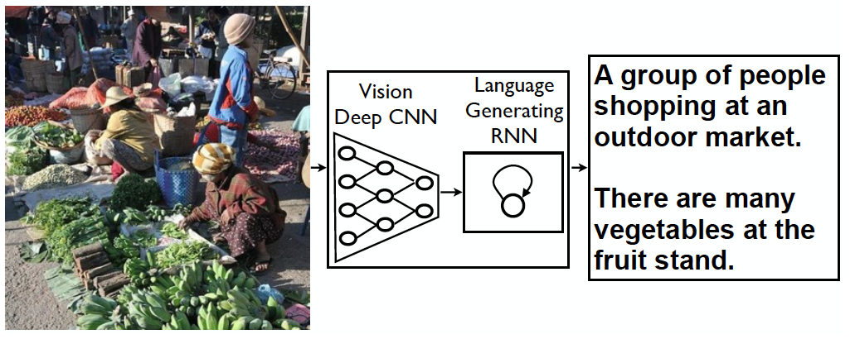
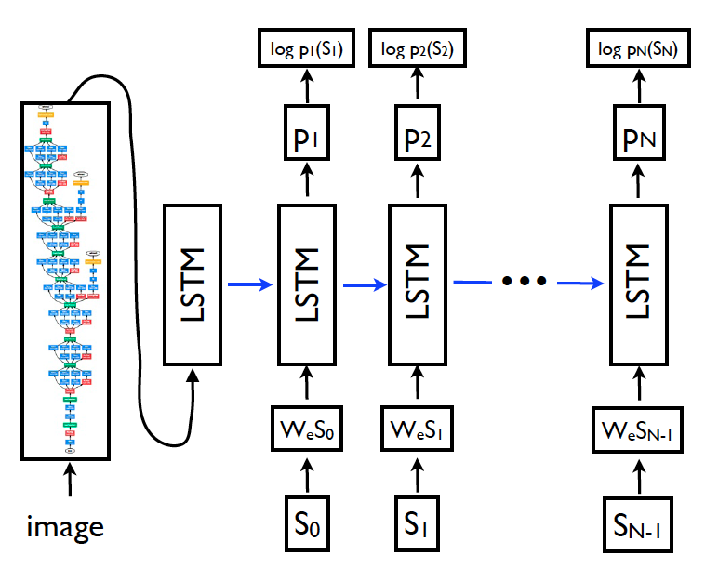
Problems with Deep Learning
Problem#2: Lack of interpretability
[Fang et al. CVPR15]
[Vinyals et al. CVPR15]
Pipeline
End-to-End

Slide 28
Problems with Deep Learning
Problem#2: Lack of interpretability
Hard to track down what’s failing
Pipeline systems have “oracle” performances at each step
In end-to-end systems, it’s hard to know why things are not working
Standard response #1
Tricks of the trade: visualize features, add losses at different layers, pre-train to avoid degenerate initializations…
“We’re working on it”
Standard response #2
“Yes, but it often works!”

Slide 29
Problems with Deep Learning
Problem#3: Lack of easy reproducibility
Direct consequence of stochasticity & non-convexity
different initializations → different local minima
Standard response #1
It’s getting much better
Standard toolkits/libraries/frameworks now available
PyTorch, TensorFlow, MxNet…
Standard response #2
“Yes, but it often works!”

Slide 30
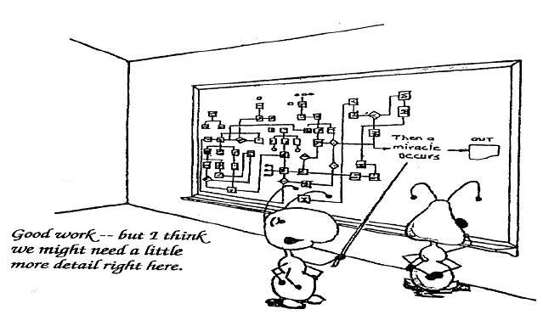
Yes it works, but how?

Slide 31
A Basic Concept: N-dimensional Array

Slide 32
N-dimensional Array Examples
• N-dimensional array, short for ndarray, is the main data
structure for machine learning and neural networks
0-d (scalar)
1.0
A class label
1-d (vector)
[1.0, 2.7, 3.4]
A feature vector
2-d (matrix)
[[1.0, 2.7, 3.4] [5.0, 0.2, 4.6] [4.3, 8.5, 0.2]]
A example-by- feature matrix

Slide 33









ND Array Examples, cont
3-d
[[[0.1, 2.7, 3.4] [5.0, 0.2, 4.6] [4.3, 8.5, 0.2]]
[[3.2, 5.7, 3.4] [5.4, 6.2, 3.2] [4.1, 3.5, 6.2]]]
A RGB image (width x height x channels)
4-d
[[[[. . . . . .
. . .]]]
A batch of RGB images (batch-size x width x height x channels)
5-d
[[[[. . . . . .
. . .]]]
A batch of videos (batch-size x time x width x height x channels)

Slide 34
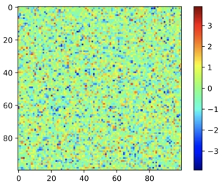
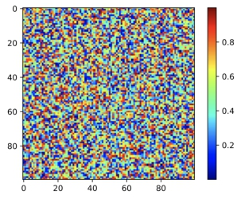
Create Arrays
• Create arrays with
• A shape, e.g. 3-by-4 matrix
• Data type for each element, e.g. float
• Element values, e.g all 0s, or random values
A normal distribution A uniform distribution
100-by-100 matrix with elements generated from

Slide 35
Access Elements
An element: [1, 2]
0 1 2 3
A row: [1, :]
0 1 2 3
A column: [:, 2]
0 1 2 3
0 1 2 3
1 2 3 4
5 6 7 8
9 10 11 12
13 14 15 16
0 1 2 3
1 2 3 4
5 6 7 8
9 10 11 12
13 14 15 16
0 1 2 3
1 2 3 4
5 6 7 8
9 10 11 12
13 14 15 16
0 1 2 3
1 2 3 4
5 6 7 8
9 10 11 12
13 14 15 16
0 1 2 3
1 2 3 4
5 6 7 8
9 10 11 12
13 14 15 16
0 1 2 3
0 1 2 3

Slide 36
Software & Implementation

Slide 37
Agenda
Anaconda
Jupyter Notebooks,
Reproducible Research
GitHub – version control

Slide 38

Anaconda
https://www.anaconda.com/

Slide 39
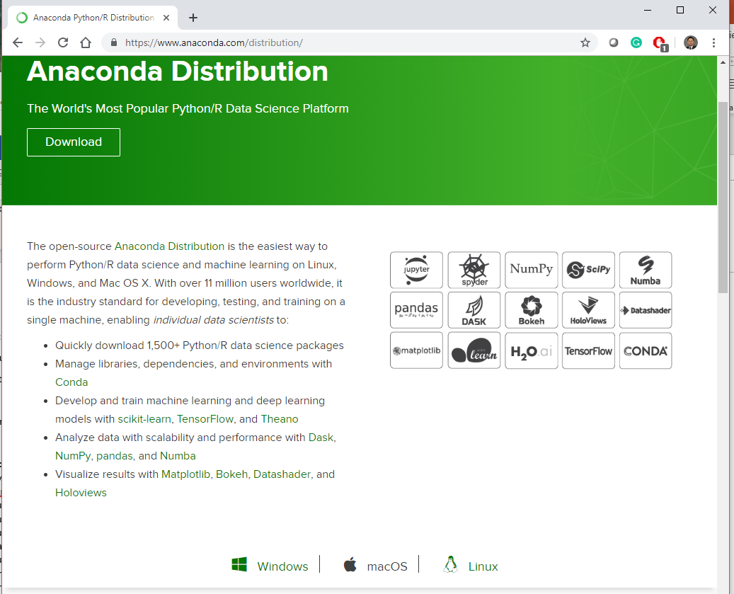
Download
https://www.anaconda.com/distribution/

Slide 40
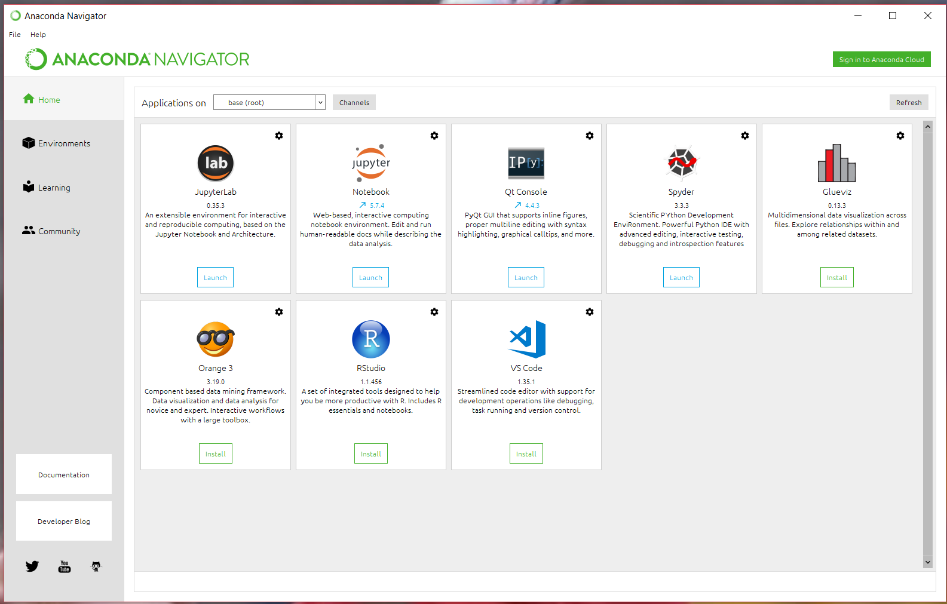
After installation

Slide 41
What is Conda?
Conda is an open source package and environment management system that runs on Windows, Mac OS and Linux.
Conda can quickly install, run, and update packages and their dependencies.
Conda can create, save, load, and switch between project specific software environments on your local computer.
Although Conda was created for Python programs, Conda can package and distribute software for any language such as R, Ruby, Lua, Scala, Java, JavaScript, C, C++, FORTRAN.

Slide 42
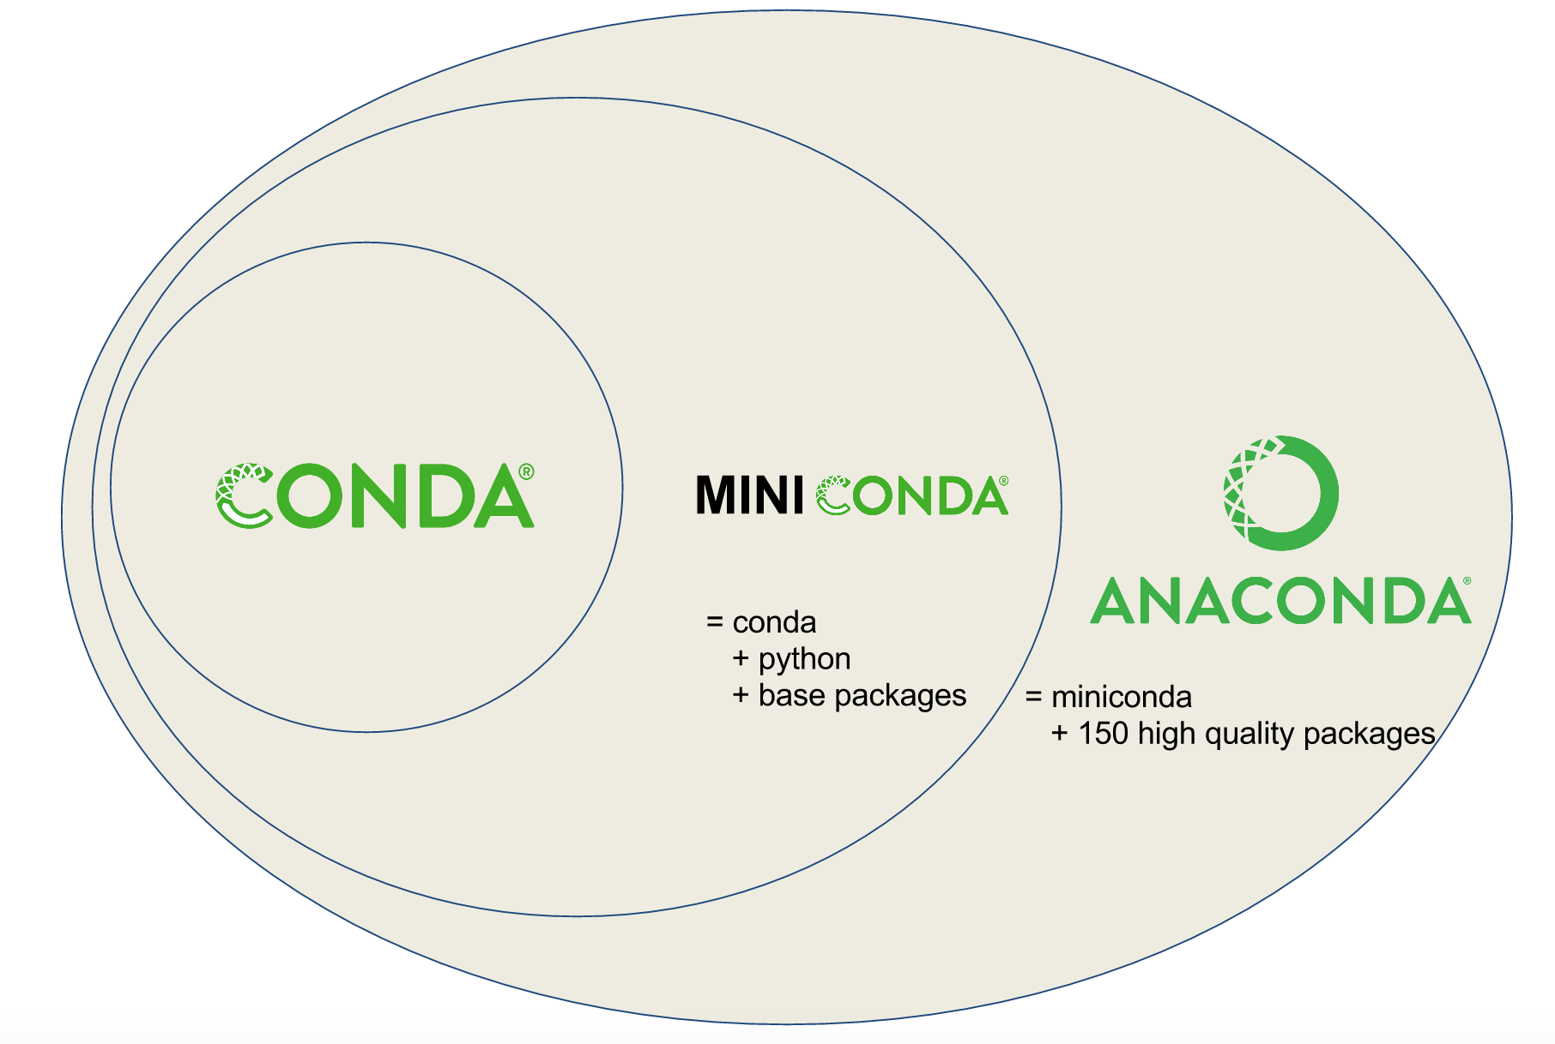
What is Anaconda?
https://kaust-vislab.github.io/python-novice-gapminder/00-getting-started-with-conda/index.html

Slide 43

GitHub

Slide 44
Tools
• Python
• Everyone is using it in machine learning & data science
• Conda package manager (for simplicity)
• Jupyter
• So much easier to keep track of your experiments
• Obviously, you should put longer code into modules

Slide 45
Software Demos
1linear-algebra.ipynb
2ndarray.ipynb
3activation.ipynb
4perceptron.ipynb

